Slide 1
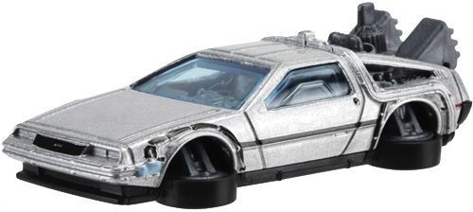
NDN DeLorean: An Authentication System for Data Archives in Named Data Networking
Yingdi Yu (UCLA), Alexander Afanasyev (Florida International University), Jan Seedorf (HFT Stuttgart), Zhiyi Zhang (UCLA), Lixia Zhang (UCLA),
ACM Information Centric Networking Conference, September 27, 2017, Berlin, Germany

Slide 2
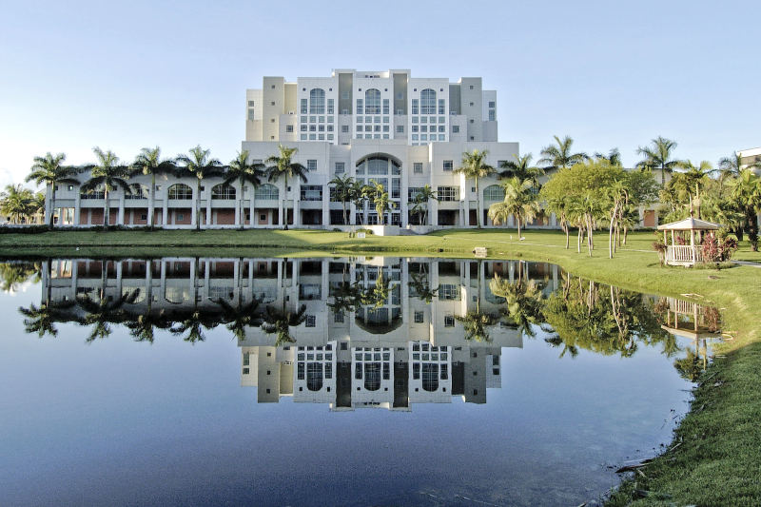
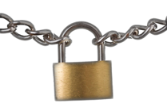
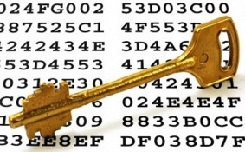
NDN and Data-Centric Security
In NDN you sign the data with a digital signature..
..so the users can check if they get the right data
Data secured both in motion and at rest
/USAToday/Headline
/2015/10/22
/html/_chunk=2
Signed by
KeyLocator: /USAToday/Author/CompuFax/KEY
/USAToday/
/Editor/Section/KEY
Signed by
KeyLocator: /USAToday/Editor-in-chief/KEY
…

Slide 3
Mismatch Between Data and Signature Lifetimes
Data lifetime can be significantly longer than its signature’s life time
Parent certificate expiration or compromise, key compromise, crypto algorithm compromise, …
Periodical re-signing unlikely to be feasible
Do not scale in long term
Data may outlive its producer
Need a ”look back” data authentication
Check signature validity at the time of data production

Slide 4
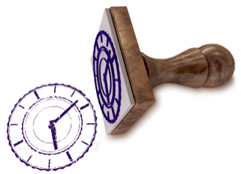

Look Back Data Authentication
Need a certified timestamp for the past time point
Trusted service
Hash-chain or block-chain
DeLorean: Multi-level Merkle-tree based hash chain
Timestamp/Bookkeeping Service
Producer
Consumer
Notes:
Design challenges
how to tell the timestamp service is honest?
scale with the number of timestamp records

Slide 5

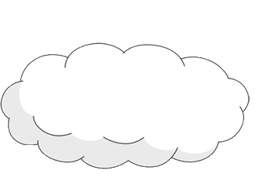
DeLorean Workflow Overview
Request proofs of signature existence
Publishers
DeLorean Service
Retrieve proofs
Retrieve data and part of volume chronicle as a proof; verify proof and signature
Aggregate requests and publish “Chronicle Volumes”
for rolling time periods
Consumers
Security through publicity
Audit published volumes
Storage
Auditors
Notes:
Auditor: part of security through publicity
Neither service nor storage are trusted
Publishers

Slide 6
DeLorean Chronicle Tree Construction
Chronicle
K-ary Merkle tree
Root hash (chonicle digest) fixes the state of the Chronicle
Each new volume updates nodes along the path to root
May create new root and intermediate nodes
Existence verification:
O(log_{k}m)
Consistence verification:
O(log_{k}m)
Add/check volume to/in 20 year old 32-ary Chronicle with 10-min wide Volumes
4 hash computations
Chronicle digest
Chronicle digest
h_{i,n} = H(h_{i-1,nk^i}|h_{i-1,nk^i+1}|…|h_{i-1,nk^i+k-1})

Slide 7
DeLorean Chronicle Volume Construction
Volume
K-ary Merkle tree
Root hash (volume digest) fixes the state of the time-specific volume
Each new signature updates nodes along the path to root
May create new root and intermediate nodes
Existence verification:
O(log_{k}m)
Consistence verification:
O(log_{k}m)
Add/check signature to/in a Volume with > 1,000,000 signatures
4 hash computations
Chronicle digest
Volume digest
h_{i,n} = H(h_{i-1,nk^i}|h_{i-1,nk^i+1}|…|h_{i-1,nk^i+k-1})

Slide 8
Proof of Existence
Existence of volume v₄ in the Chronicle at time t₄
{ c’_{1,2}, c’_{2,1}, c’_{3,0} }
Existence of signature s₂ in volume v₄ (at time t₄)
{ v’_{1,1}, c’_{2,0}, }
Each node of chronicle and volume tree is published as NDN data packet
“Complete” nodes
Final version: all children are present and fixed
“Incomplete” nodes
Transient state
The latest transient node ”fixes” all previous nodes
Chronicle digest
Volume digest

Slide 9
Proof of Consistency
Periodic retrieval of current chronicle root
c_{2,0}, c’_{3,0}, c’’_{3,0}, …
Check if the “newer” root
incorporates the old root (if old root complete)
References the same subset of children (if incomplete)
Easy to catch misbehavior
Trivial networking and storage burden on auditors
Only root node needs to be stored
Usually one node retrieval

Slide 10
NDN Data Packet for DeLorean Nodes (Chronicle)
Signed by the DeLorean service for provenance only
Naming convention
uniquely identify a node in a particular state of Chronicle and/or Volume tree
Given a time point, the name of any node is determined
/[service-prefix]/_CHRONICLE/[NODE-STATE]/[layer],[index]/[hash]
/DeLorean/_CHRONICLE/incomplete=2050/1,64/1ffa1
/DeLorean/_CHRONICLE/incomplete=2050/2,2/abc1e3
/DeLorean/_CHRONICLE/complete/2,0/a2ed8b

Slide 11
NDN Data Packet for DeLorean Nodes (Volume Trees)
Signed by the DeLorean service for provenance only
Naming convention
uniquely identify a node in a particular state of Chronicle and/or Volume tree
/[service-prefix]/_VOLUME-[time-index]/[NODE-STATE]/[layer],[index]/[hash]

Slide 12
Node Retrieval
Nodes at higher layers are frequently retrieved and benefit from caching
Complete never change
Most higher-level incomplete nodes don’t change often
Can be replicated anywhere in the network

Slide 13
Public Audit with Merkle Tree
All the users can verify consistence of the timestamp service
More users, the more secure and (publicly) reliable
Each published volume needs to be checked ~ at time of published to ensure timestamp trust
Difficult to create double history
NDN interest does not carry sender address
Interest may not reach timestamp service (satisfied by cache)
/DeLorean/_CHRONICLE/incomplete=2050/1,64/1ffa1
From whom?
/DeLorean/_CHRONICLE/incomplete=2050/1,64/1ffa1

Slide 14
Evaluation: Overview
Analytical evaluations
Necessary storage capabilities at the DeLorean service provider
Verification cost at users
Needed number of auditors and audits per auditor
Keep in mind …
Not every signature goes to DeLorean
For large volume archives, DeLorean need to track only signature of a manifest
Real-world example: newspaper archive in public libraries
(based on data from statistica.com)
700.000 pieces of newspaper content published per day
on average 486 pieces of content published per minute

Slide 15
Evaluation: DeLorean Service Storage Requirements
Yearly storage requirement is linear to the number of witnessed signatures
Amount of data a user would need to retrieve to verify the existence of a signature at a certain point in the past:
For 32-ary trees and volume timeslot 10 minutes
1500-byte data packet retrieval for the first 20 years
4 x 1500-byte data packet retrieval for years 20-600
Verification costs clearly negligible!
Yearly storage requirements at DeLorean service provider depending on signatures per minute
(Arity of Merkle tree: 32; duration of a timeslot within a volume: 10 minutes)
Notes:
Amount of data a user would need to retrieve to verify the existence of a signature at a certain point in the past:
For 32-ary trees and volume timeslot 10 minutes
1500-byte data packet retrieval for the first 20 years
4 x 1500-byte data packet retrieval for years 20-600
Verification costs clearly negligible!

Slide 16
Evaluation: Required Number of Auditors
Decentralized auditing
Evaluation: probability that there is a volume that has not been verfiied by at least one auditor around the time the volume has been finalized
Period during which each auditor fetches the chronlice at least once
Timeslot for volume creation
Notes:
Incentives to audit
Users, Providers, Competitors
Recovery from inconsistency
“Bulletin boards” to post detected problems
Auditors cannot forge bad reports because of NDN signatures
Transition to new provider(s)
Relation to real-time data production

Slide 17
Discussion and Future Work
Incentives to audit
Users
Providers
Competitors
Recovery from inconsistency
“Bulletin boards” to post detected problems
Auditors cannot forge bad reports because of NDN signatures
Transition to new provider(s)
Relation to real-time data production
Produce now, get proof of existence later
Notes:
There is no word for discussion? Just a long list of issues?? E.g. what do you plan to say about Multiple DeLorean providers?
Also not sure if you would have time to touch upon all of them. How about pick 3 or 5 most interesting ones, and add “see further issues from the paper”

Slide 18
Summary
With data-centric security, data lifetime can be longer than its signing key’s validity period
DeLorean provides publicly verifiable (“trust through transparency”) bookkeeping service to enable “look back” validation of long-lived data
Collects signatures (signature digests) from producers
Publishes volumes of signatures collected within corresponding time periods
Efficient (storage, update, and lookup) Merkle-tree structure for signature volumes and chronicle of volumes
Opportunities
Decouple the lifetime of data and signature
Make short-lived keys feasible

